Slide 1
Security Fundamentals

Slide 2

Information Security
Information - collection of facts organized in such a way that they have additional value beyond the value of the facts themselves.
Information System - is a set of interrelated components that collect or retrieve, process, store and distribute information to support decision making and control in an organization.

Slide 3
Information Security - Definition
Protection of information systems against unauthorized access to or modification of information, whether in storage, processing or transit, and against the denial of service to authorized users or the provision of the service to unauthorized users, including those measures necessary to detect, document, and counter such threats.
- U.S. Govt.’s NIA Glossary

Slide 4
Need for Information Security
Use of IT across businesses
Fast growth of Internet
Commercialization of Internet
Theft of confidential data
Virus / Worms/ Trojans /Spyware / Adware
Hackers
Financial Frauds
Legal requirements

Slide 5
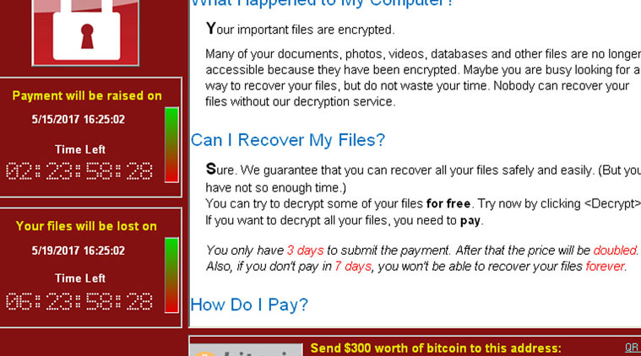
Need for Information Security

Slide 6
Information Security - CIA Triad
Confidentiality
Integrity
Availability

Slide 7
Information Security
Confidentiality
It is the principle that information will not be disclosed to unauthorized subjects.

Slide 8
Information Security
Integrity
It is the protection of system information or process from intentional or accidental unauthorized changes.

Slide 9
Information Security
Availability
It defines that information or resources are available to authorize users when required.

Slide 10
Information Security - Terms
Threat
A threat is a possible event that can damage or harm an Information System.
Vulnerability
It is the weakness within a system. It is the degree of exposure in view of threat.

Slide 11
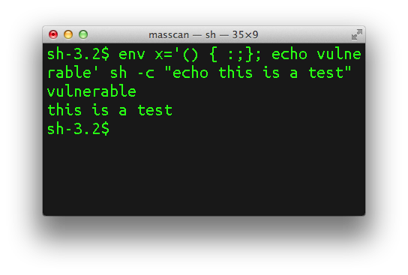


Vulnerability

Slide 12
Information Security
Risk
The potential for loss or damage when a threat exploits a vulnerability.
Risk = Threat X Vulnerability
Exploit
A method or way to take advantage of a vulnerability within a system or software to perform illegal actions.

Slide 13
Information Security - Risk Assessment
NIST Definition
The risk assessment includes: (i) the identification of threats to and vulnerabilities in the information system; (ii) the potential impact or magnitude of harm that a loss of confidentiality, integrity, or availability would have on agency operations (including mission, functions, image, or reputation) or agency assets should there be a threat exploitation of identified vulnerabilities; and (iii) the identification and analysis of security controls for the information system.

Slide 14
Information Security - Risk Assessment
1. Information Classification
Military / Government
Top Secret – The most retricted and controlled information.The unauthorized disclosure of such information can be expected to cause exceptionally grievous damage. It is the highest level in this classification scheme.
Secret – The unauthorized disclosure of such data can be expected to cause significant damage.

Slide 15
Information Security - Risk Assessment
1. Information Classification
Military / Government
Confidential – A classification that identifies sensitive, private, proprietary and highly valuable data. The unauthorized disclosure of such data can be expected to cause serious, noticeable damage.
Unclassified – The lowest level of classification scheme. Actually this data is neither sensitive nor classified, and hence it is available to anyone.

Slide 16
Information Security - Risk Assessment
1. Information Classification
Business
Confidential – It is the highest level in this classification scheme. Identifies most sensitive data. A considerable amount of damage may occur for an organization given this confidential data is compromised.
Private – It identifies business data meant for internal use only whose significance is great and its disclosure may cause a significant negative impact on an organization.

Slide 17
Information Security - Risk Assessment
1. Information Classification
Business
Sensitive - Data that is not much sensitive but may have some negative impact on the organization.
Public – The data that does not carry any significant sensitivity. The disclouser may not cause any damage to the organization. The lowest level of classification.

Slide 18
Information Security - Risk Assessment
2. Asset Identification
Asset – assets are the information and resources that have value to the organization.
Examples include buildings, equipments, personnel, organization reputation, business documents, and many other tangible and intangible items.

Slide 19
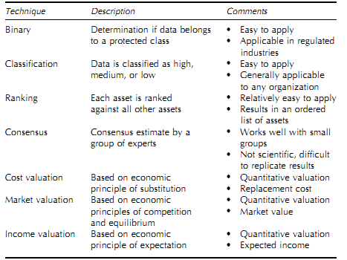
Information Security - Risk Assessment
2. Asset Identification
Asset Valuation

Slide 20
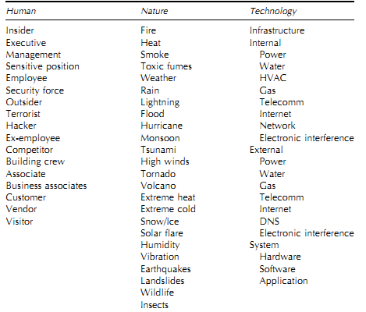
Information Security - Risk Assessment
3. Threat Identification
Threat Agent
A threat agent is an entity that may cause a threat to happen

Slide 21
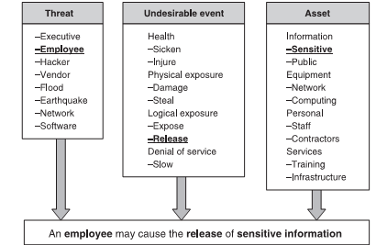
Information Security - Risk Assessment
3. Threat Identification
Threat Statements

Slide 22
Information Security - Risk Assessment
Example threat stements.
A vendor may accidently slow down the network.
A vendor may deliberately slow down the network
An earthquake may damage the infrastructure
A software may expose sensitive information.

Slide 23
Information Security - Risk Assessment
Threat statement validation.
Five things to be considered while evaluating threat
Asset
Something of value to the organization
Actor / Attacker
Who or what may violate the security requirement
Motive
Deliberate or accidental
Access
How the attacker will access the asset.
Loss
Loss due a threat

Slide 24
Information Security - Risk Assessment
Cost of a threat can be calculated considering following factors
Productivity
No. of employees affected
No. of hours wasted
Cost per hour / per employee
Revenue
Direct financial loss
Future business loss
Financial Performance
Credit rating and stock price

Slide 25
Information Security - Risk Assessment
Cost of a threat can be calculated considering following factors
Other Expenses
Overtime Costs
Travel Expenses
Third Party costs
Equipment Rental Costs
Hidden Costs
Difficult to calculate
Cost of damaged reputation
Loss of faith by customers, bankers or vendors

Slide 26
Information Security - Risk Assessment
Risk calculation
When it is done using subjective judgment approach is called qualitative analysis.
Qualitative analysis relies on the subjective judgment of the security risk assessment team to determine the overall risk to the information systems.
Qualitative values have order.
These values are hierarchical. For example,
High > Medium > Low

Slide 27
Information Security - Risk Assessment
Risk calculation
When some computational method i.e. some formula is used to determine the values of the risk variables, it is called quantitative analysis.
Quantitative analysis is an approach that relies on specific formulas and calculations to determine the value of the risk decision variables.

Slide 28
Information Security - Risk Assessment
Quantitative Analysis
An exposure factor is the average amount of loss to the asset for a single incident.
Single loss expectancy (SLE) is the expected loss as the result of a single incident.
Annual rate of occurrence (ARO) is simply a prediction of how often a specific risk event is likely to happen each year.

Slide 29
Information Security - Risk Assessment
Single Loss Expectancy = Asset Value X Exposure Factor.
Annual Loss Expectancy (ALE) = Single Loss Expectancy X Annual Rate of Occurrence
Safeguard Value = ALE Before - ALE After - Annual Safeguard Cost.

Slide 30
Information Security - Risk Assessment
Safeguard value is defined as the reduction experienced in the annualized loss expectancy minus the annual cost of implementing the countermeasure.

Slide 31
Information Security - Risk Assessment
Risk Mitigation Options
Risk Avoidance
Avoid activities involving greater risk
Use alternate solutions
Risk Termination
Eliminate risk by removing the source
Risk Reduction
Minimize probability of occurrence of risk
Risk Minimization
Reduce the impact on the organization
Risk Transfer
Insurance

Slide 32
Information Security - Risk Assessment
The controls, countermeasures and safeguards are implemented to manage risks.
They can be implemented physically, Administratively or Technically.
Doors, secure facilities, fire extinguishers, flood protection, and air conditioning are some of the examples of physical controls.

Slide 33
Information Security - Risk Assessment
Administrative controls are implemented through organization’s policies, procedures, and guidelines intended to facilitate information security.
Technical controls are the various technical measures, such as firewalls, authentication systems, intrusion detection systems, and file encryption, etc.
These controls mayy be furthur categorized by their functionality (preventive, detective, corrective, deterrent, recovery, and compensating etc.)

Slide 34
Information Security - Risk Assessment
Preventive Controls
Preventive controls work to prevent security violations and enforce access control.
Authentication, Authorization, Access Control Lists, Nonrepudiation, Assigning responsibilities, Security policies, Security awareness and training, Doors etc.

Slide 35
Information Security - Risk Assessment
Detective Controls
Detective controls are placed to detect security violations and generate an alert.
They come into action when the preventive control has faile or have been circumvented.
Audits, Intrusion Detection System, Background Checks, Personnel Clearance

Slide 36
Information Security - Risk Assessment
Corrective controls
Corrective controls try to correct the situation after a security violation has happened.
Deterrent Controls
Deterrent controls are intended to discourage potential attackers and send the message that it is better not to attack, but even if you decide to attack we are able to defend ourselves.

Slide 37
Information Security - Risk Assessment
Recovery Controls
Recovery controls are somewhat like corrective controls, but they are applied in more serious situations to recover from security violations and restore information and information processing resources.
Recovery controls may include disaster recovery and business continuity mechanisms, backup systems and data,

Slide 38
Information Security - Risk Assessment
Compensating controls
Compensating controls are intended to be alternative arrangements for other controls when the original controls have failed or cannot be used.
When a second set of controls addresses the same threats that are addressed by another set of controls, the second set of controls are compensating controls.

Slide 39
Information Security - Risk Assessment
Security Policy
A security policy is a statement produced by the senior management of an organization to dictate what type of role security plays within the organization.
ISO standard 17799 defines security policy as
Management should set a clear policy direction and demonstrate support for , and commitment to , information security through the issue and maintenance of an information security policy across the organization.

Slide 40
Information Security - Risk Assessment
Security Policy
A security policy is essentially a document stating security goals, and which actions are required, which are permitted and which are allowed.
Examples of Policy Areas
Employee email usage
Employee web browsing usage
Privacy of user information
Password selection and protection
Handling of proprietary information
Cryptographic policy (what needs to be encrypted, what algorithms/implementations/key lengths to use)
Remote Access
Protection of employee issued laptops (physical and network connections)

Slide 41
Information Security - Risk Assessment
Security Audits
A systematic evaluation of the security of a company’s information system by measuring how well it confirms to a set of established criteria.
Security audits are often used to determine regulatory compliance.
A security audit is performed to check a system’s physical configuration and environment, software, information handling components and user practices.

Slide 42


Slide 43


